Slide 1
Decision Trees
Jayaraj P B
1

Slide 2
Decision Tree is a Supervised learning technique that can be used for both classification and Regression problems. But mostly it is preferred for solving Classification problems.
It is a tree-structured classifier, where internal nodes represent the features of a dataset, branches represent the decision rules and each leaf node represents the outcome.
It is a graphical representation for getting all the possible solutions to a problem/decision based on given conditions
In a Decision tree, there are two nodes, which are the Decision Node and Leaf Node. Decision nodes are used to make any decision and have multiple branches, whereas Leaf nodes are the output of those decisions and do not contain any further branches.

Slide 3
The decisions or the test are performed on the basis of features of the given dataset.
It is called a decision tree because, similar to a tree, it starts with the root node, which expands on further branches and constructs a tree-like structure.
A decision tree simply asks a question, and based on the answer (Yes/No), it further split the tree into subtrees.
They are very powerful algorithms, capable of fitting complex datasets.

Slide 4

The general structure of a decision tree

Slide 5
Why use Decision Trees?
There are various algorithms in Machine learning, so choosing the best algorithm for the given dataset is important. The main two reasons for using the Decision tree are
Decision Trees usually mimic human thinking ability while making a decision, so it is easy to understand.
The logic behind the decision tree can be easily understood because it shows a tree-like structure.

Slide 6
Model Interpretation: White Box Versus Black Box
Decision Trees are fairly intuitive and their decisions are easy to interpret. Such models are often called white box models.
In contrast, as we will see, Random Forests or neural networks are generally considered black box models. DT make great predictions, and you can easily check the calculations that they performed to make these predictions;
For example, if a neural network says that a particular person appears on a picture, it is hard to know what actually contributed to this prediction: did the model recognize that person’s eyes? Her mouth? Her nose? Her shoes? Or even the couch that she was sitting on? Conversely, Decision Trees provide nice and simple classification rules that can even be applied manually if need be.

Slide 7
Decision Tree Terminologies
Root Node: Root node is from where the decision tree starts. It represents the entire dataset, which further gets divided into two or more homogeneous sets.
Leaf Node: Leaf nodes are the final output node, and the tree cannot be segregated further after getting a leaf node.
Splitting: Splitting is the process of dividing the decision node/root node into sub-nodes according to the given conditions.
Branch/Sub Tree: A tree formed by splitting the tree.
Pruning: Pruning is the process of removing the unwanted branches from the tree.
Parent/Child node: The root node of the tree is called the parent node, and other nodes are called the child nodes.

Slide 8
How does the Decision Tree algorithm Work?
In a decision tree, for predicting the class of the given dataset, the algorithm starts from the root node of the tree.
This algorithm compares the values of root attribute with the record (real dataset) attribute and, based on the comparison, follows the branch and jumps to the next node.
For the next node, the algorithm again compares the attribute value with the other sub-nodes and move further. It continues the process until it reaches the leaf node of the tree.

Slide 9
Example
Suppose there is a candidate who has a job offer and wants to decide whether he should accept the offer or Not. So, to solve this problem, the decision tree starts with the root node (Salary attribute by ASM).
The root node splits further into the next decision node (distance from the office) and one leaf node based on the corresponding labels.
The next decision node further gets split into one decision node (Cab facility) and one leaf node. Finally, the decision node splits into two leaf nodes (Accepted offers and Declined offer). Consider the below diagram:

Slide 10
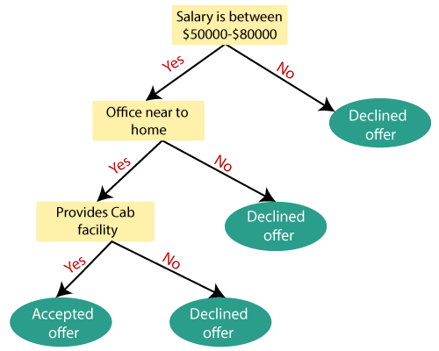
Decision Tree

Slide 11
Attribute Selection Measures
The hierarchical structure of a decision tree leads us to the final outcome by traversing through the nodes of the tree. Each node consists of an attribute or feature which is further split into more nodes as we move down the tree. But how do we decide:
Which attribute/feature should be placed at the root node?
Which features will act as internal nodes or leaf nodes?
To decide this, and how to split the tree, we use splitting measures. These splitting measures are called Attribute Selection Measure or ASM.
By this measurement, we can easily select the best attribute for the nodes of the tree. There are two popular techniques for ASM, which are:
Information Gain (Entropy)
Gini Index

Slide 12
Information Gain:
Information gain is the measurement of changes in entropy after the segmentation of a dataset based on an attribute.
Information gain for a particular feature A is calculated by the difference in entropy before a split with the entropy after the split
It calculates how much information a feature provides us about a class. According to the value of information gain, we split the node and build the decision tree.
A decision tree algorithm always tries to maximize the value of information gain, and a node/attribute having the highest information gain is split first.

Slide 13
Entropy
Entropy: Entropy is a metric to measure the impurity in a given attribute. It specifies randomness in data. Entropy can be calculated as:
Where c is the number of different class labels and p refers
to the proportion of values falling into the i^{th} class label.
we have two values for the target class ‘Job Offered?’ –
Yes and No. The value of p for class value ‘Yes’ is 0.44 (i.e.
8/18) and that for class value ‘No’ is 0.56 (i.e. 10/18). So, we
can calculate the entropy as
Entropy(S) = -0.44 log (0.44) - 0.56 log (0.56) = 0.99.

Slide 14
Training data for GTS recruitment
Global Technology Solutions (GTS), a leading provider of IT solutions, is coming to College of Engineering and
Management (CEM) for hiring B.Tech. students.
Last year
during campus recruitment, they had shortlisted 18 students
for the final interview.

Slide 15
Information Gain (S, A) = Entropy (S_{bs} ) − Entropy (S_{as} )
For calculating the entropy after split, entropy for all partitions needs to be considered. Then, the weighted summation of the entropy for each partition can be taken as the total entropy after split. For performing weighted summation, the proportion of examples falling into each partition is used as weight.

Slide 16
As calculated, entropy of the data set before split (i.e.
Entropy (S )) = 0.99, and entropy of the data set after split
(i.e. Entropy (S )) is
0.69 when the feature ‘CGPA’ is used for split
0.63 when the feature ‘Communication’ is used for split
0.52 when the feature ‘Aptitude’ is used for split
0.95 when the feature ‘Programming skill’ is used for split

Slide 17
Entropy and information gain calculation (Level 1)

Slide 18
Therefore, the information gain from the feature ‘CGPA’ =
0.99 − 0.69 = 0.3, whereas the information gain from the
feature ‘Communication’ = 0.99 − 0.63 = 0.36. Likewise, the
information gain for ‘Aptitude’ and ‘Programming skills’ is
0.47 and 0.04, respectively
Hence, it is quite evident that among all the features,
‘Aptitude’ results in the best information gain when adopted
for the split. So, at the first level, a split will be applied
according to the value of ‘Aptitude’ or in other words,
‘Aptitude’ will be the first node of the decision tree formed.

Slide 19
As a part of level 2, we will thus have only one branch to navigate in this case – the one for Aptitude = High. Figure below presents calculations for level 2.
As can be seen from the figure, the entropy value is as follows:
0.85 before the split
0.33 when the feature ‘CGPA’ is used for split
0.30 when the feature ‘Communication’ is used for split
0.80 when the feature ‘Programming skill’ is used for split

Slide 21
Hence, the information gain after split with the features
CGPA, Communication and Programming Skill is 0.52, 0.55
and 0.05, respectively. So, at the second level, a split will be
applied on the basis of the value of ‘Communication’.
As a part of level 3, we will thus have only one branch to
navigate in this case – the one for Communication = Bad.
Figure below presents calculations for level 3.
As can be seen from the figure, the entropy value is as follows:
0.81 before the split
0 when the feature ‘CGPA’ is used for split
0.50 when the feature ‘Programming Skill’ is used for split

Slide 22
Entropy and information gain calculation (Level 3)

Slide 23
Hence, the information gain after split with the feature CGPA is 0.81, which is the maximum possible information gain (as the entropy before split was 0.81).
Hence, as obvious, a split will be applied on the basis of the value of ‘CGPA’. Because the maximum information gain is already achieved, the tree will not continue any further.

Slide 25
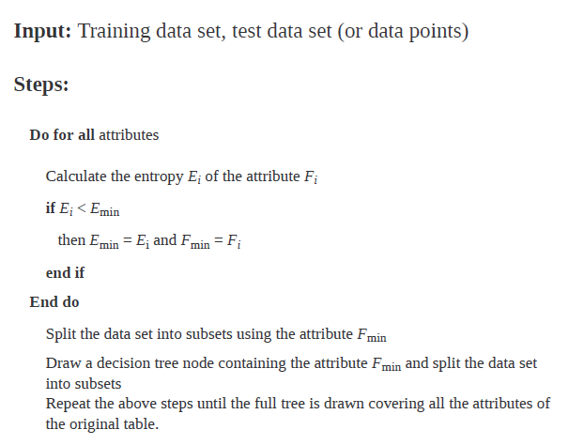
DT - Algorithm

Slide 26
Gini Index:
Gini index is a measure of impurity or purity used while creating a decision tree.
An attribute with the low Gini index should be preferred as compared to the high Gini index.
It only creates binary splits, and the CART algorithm uses the Gini index to create binary splits.
Gini index can be calculated using the below formula:
Gini Index = 1- ∑_{j}P_{j}²
Where ‘pi’ is the probability of an object being classified to a particular class.

Slide 27
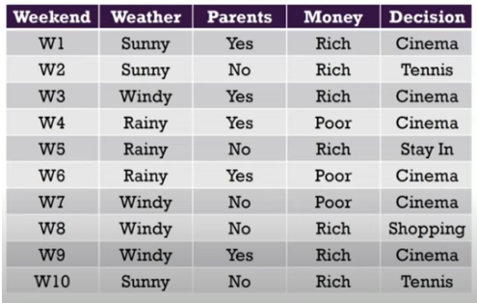
Building Decision Tree using Gini Index

Slide 28
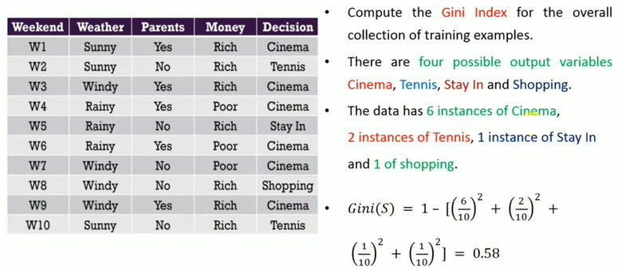
Gini Index of the dataset

Slide 29
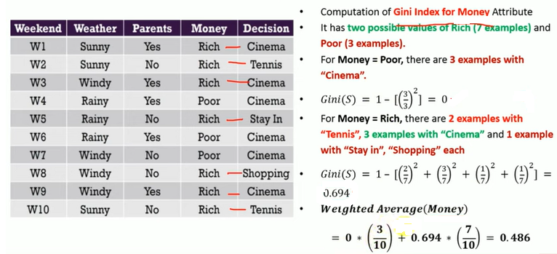
Gini index for Money

Slide 30
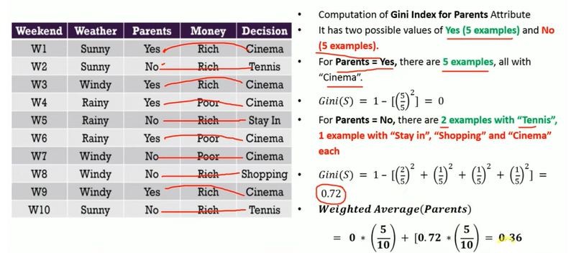
Gini index for Money

Slide 31
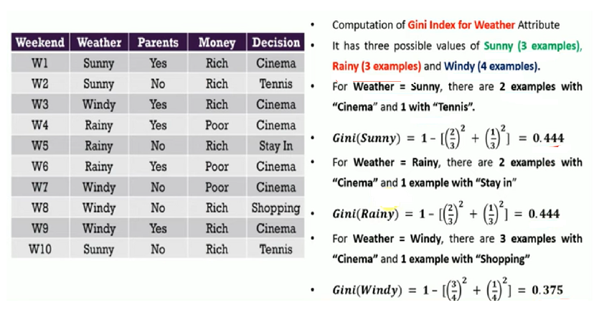

Slide 32
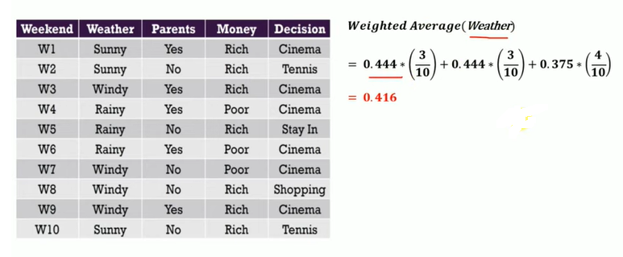

Slide 33
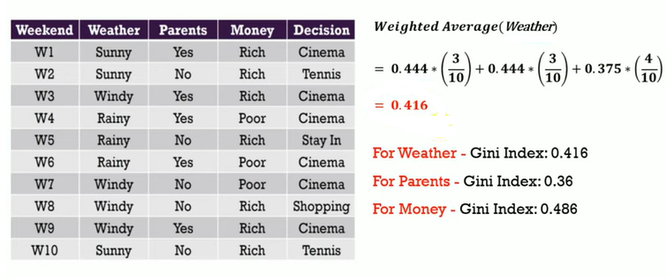

Slide 34
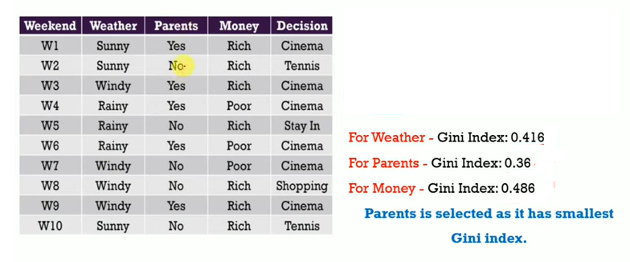

Slide 35
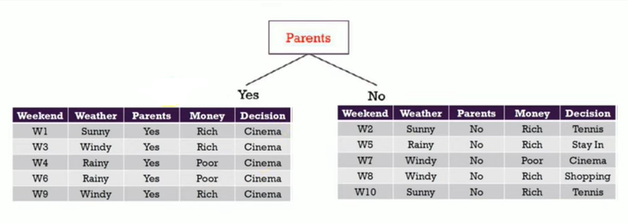
DT Construction

Slide 36
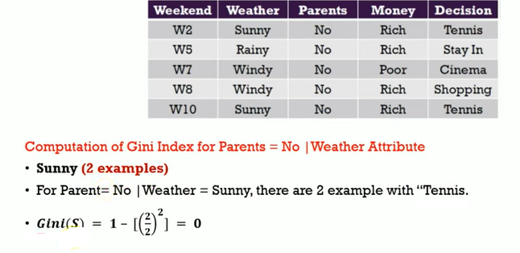

Slide 37
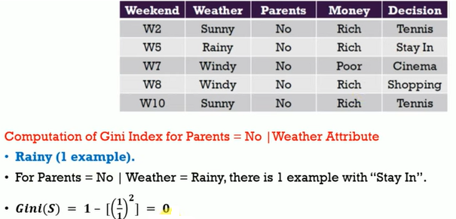

Slide 38
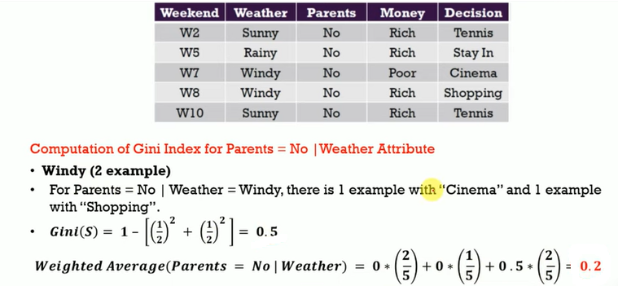

Slide 39
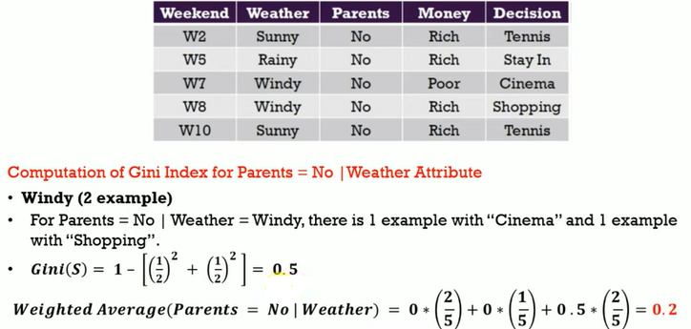

Slide 40
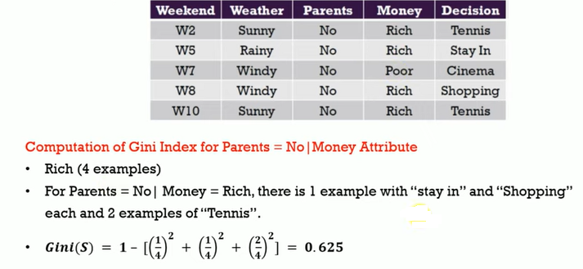

Slide 41
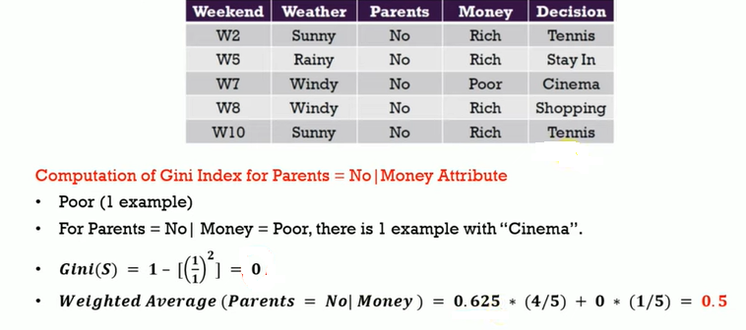

Slide 42
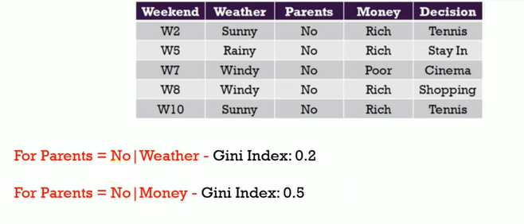

Slide 43
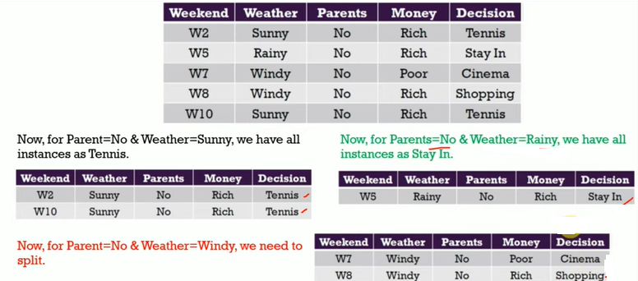

Slide 44
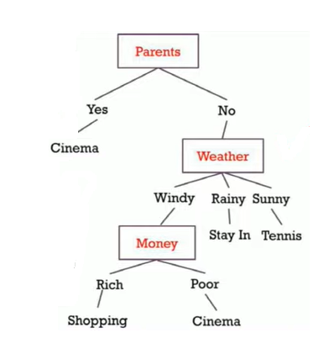
Final Decision Tree

Slide 45
Avoiding overfitting in decision tree – pruning
The decision tree algorithm, unless a stopping criterion is applied, may keep growing indefinitely – splitting for every feature and dividing into smaller partitions till the point that the data is perfectly classified. This, as is quite evident, results in overfitting problem.
To prevent a decision tree getting overfitted to the training data, pruning of the decision tree is essential.

Slide 46
Pruning:
Pruning: Getting an Optimal Decision tree
Pruning is a process of deleting the unnecessary nodes from a tree in order to get the optimal decision tree.
A too-large tree increases the risk of overfitting, and a small tree may not capture all the important features of the dataset.
There are mainly two types of tree pruning technology used:
Pre-pruning: Stop growing the tree before it reaches perfection.
Post-pruning: Allow the tree to grow entirely and then post-prune some of the branches from it.

Slide 47
Accuracy Vs Computational cost
In the case of pre-pruning, the tree is stopped from further growing once it reaches a certain number of decision nodes or decisions. Hence, in this strategy, the algorithm avoids overfitting as well as optimizes computational cost. However, it also stands a chance to ignore important information contributed by a feature which was skipped, thereby resulting in miss out of certain patterns in the data.
On the other hand, in the case of post-pruning, the tree is allowed to grow to the full extent. Then, by using certain pruning criterion, e.g. error rates at the nodes, the size of the tree is reduced. This is a more effective approach in terms of classification accuracy as it considers all minute information available from the training data. However, the computational cost is obviously more than that of pre-pruning.

Slide 48
Hyperparameters
The DecisionTreeClassifier class has a few other parameters that similarly restrict the shape of the Decision Tree:
min_samples_split (the minimum number of samples a node must have before it can be split),
min_samples_leaf (the minimum number of samples a leaf node must have),
min_weight_fraction_leaf (same as min_samples_leaf but expressed as a fraction of the total number of weighted instances),
max_leaf_nodes (maximum number of leaf nodes), and
max_features (maximum number of features that are evaluated for splitting at each node).

Slide 49
Regularization Hyperparameters
Decision Trees make very few assumptions about the training data. If left unconstrained, the tree structure will adapt itself to the training data, fitting it very closely, and most likely overfitting it.
Such a model is often called a nonparametric model, not because it does not have any parameters (it often has a lot) but because the number of parameters is not determined prior to training, so the model structure is free to stick closely to the data.
In contrast, a parametric model such as a linear model has a predetermined number of parameters, so its degree of freedom is limited, reducing the risk of overfitting.
Increasing min_* hyperparameters or reducing max_* hyperparameters will regularize the model.

Slide 50
Computational Complexity
Making predictions requires traversing the Decision Tree from the root to a leaf.
Decision Trees are generally approximately balanced, so traversing the Decision Tree requires going through roughly O(log₂(m)) nodes. Since each node only requires checking the value of one feature, the overall prediction complexity is just O(log₂(m)), independent of the number of features. So predictions are very fast, even when dealing with large training sets.
However, the training algorithm compares all features (or less if max_features is set) on all samples at each node. This results in a training complexity of O(n × m log(m)).

Slide 51
There are many implementations of decision tree, the most
prominent ones being C5.0, CART (Classification and
Regression Tree), CHAID (Chi-square Automatic Interaction
Detector) and ID3 (Iterative Dichotomiser 3) algorithms. The
biggest challenge of a decision tree algorithm is to find out
which feature to split upon.
Entropy is a measure of impurity of an attribute or feature adopted by many algorithms such as ID3 and C5.0.
There are other measures like Gini index or chi-square for individual nodes to decide the feature on the basis of which the split has to be applied.
The CART algorithm uses Gini index, while the CHAID
algorithm uses chi-square for deciding the feature for
applying split.

Slide 52
CART
To build the Decision Tree, CART - Classification and Regression Tree algorithm is used.
It works by selecting the best split at each node based on metrics like Gini impurity or information Gain. In order to create a decision tree.

Slide 53
Basic steps of the CART algorithm:
The root node of the tree is supposed to be the complete training dataset.
Determine the impurity of the data based on each feature present in the dataset. Impurity can be measured using metrics like the Gini index or entropy
Then selects the feature that results in the highest information gain or impurity reduction when splitting the data.
For each possible value of the selected feature, split the dataset into two subsets (left and right), one where the feature takes on that value, and another where it does not. The split should be designed to create subsets that are as pure as possible with respect to the target variable.

Slide 54
5. Based on the target variable, determine the impurity of each resulting subset.
6. For each subset, repeat steps 2–5 iteratively until a stopping condition is met. For example, the stopping condition could be a maximum tree depth, a minimum number of samples required to make a split or a minimum impurity threshold.
7. Assign the majority class label for classification tasks or the mean value for regression tasks for each terminal node (leaf node) in the tree.

Slide 55
Iterative Dichotomiser3 Algorithm
ID3 or Iterative Dichotomiser3 Algorithm is used in machine learning for building decision trees from a given dataset. It was developed in 1986 by Ross Quinlan.
It is a greedy algorithm that builds a decision tree by recursively partitioning the data set into smaller and smaller subsets until all data points in each subset belong to the same class.
It employs a top-down approach, recursively selecting features to split the dataset based on information gain.
ID3 deals primarily with categorical properties, which means that it can efficiently handle objects with a discrete set of values. T

Slide 56
How ID3 Algorithms work?
The ID3 algorithm works by building a decision tree, which is a hierarchical structure that classifies data points into different categories and splits the dataset into smaller subsets based on the values of the features in the dataset.
The ID3 algorithm then selects the feature that provides the most information about the target variable.
The decision tree is built top-down, starting with the root node, which represents the entire dataset.
At each node, the ID3 algorithm selects the attribute that provides the most information gain about the target variable.
The attribute with the highest information gain is the one that best separates the data points into different categories.

Slide 57
Decision Trees Have High Variance
The main issue with decision trees is that they high variance
Small changes to the hyperparameters or to the data may produce very different models
Sci-kit learn randomly selects the features to evaluate at each node. So retraining with same data may produce a different model
Luckily, by averaging predictions over many trees, its possible to reduce variance significantly. Such an ensemble of tree is called a random forest, and it is one of the most powerful type of ML model available today

Slide 58
Advantages of the Decision Tree
It is simple to understand as it follows the same process which a human follow while making any decision in real-life.
It can be very useful for solving decision-related problems.
It helps to think about all the possible outcomes for a problem.
There is less requirement of data cleaning compared to other algorithms

Slide 59
Disadvantages of the Decision Tree
The decision tree contains lots of layers, which makes it complex.
It may have an overfitting issue, which can be resolved using the Random Forest algorithm.
For more class labels, the computational complexity of the decision tree may increase.

Slide 60
Balancing overfitting and underfitting in decision tree is a
very tricky topic, involving more of an art than science.
The way to master this art is experience in working with
more number of data sets with a lot of diversity.
THANKS!!!

